Slide 1


10ALYTICS CAPSTONE PROJECT
DIABETES PREDICTION
Using Machine Learning
Presented by:
Victoria Nwobodo
https://github.com/vezeukwu/Diabetes-Prediction-EDA-and-ML

Slide 2


INTRODUCTION Diabetes affects millions globally, requiring early detection for better management, while traditional diagnostic methods has been in use, it can be time-consuming and reactive. As Data Scientist, the use of machine learning can enhance early diagnosis and help doctors make data-driven decisions.
SITUATION
Stark Health Clinic is a leading healthcare provider whose patients are at risk of developing diabetes. The clinic is concerned about the huge cost of treatment (financial and otherwise) and intends to early detect the disease in order to prevent late intervention that could lead to severe health complications.
TASK
To develop a predictive model to classify patients as diabetic or non-diabetic based on medical data.
To improve early diagnosis accuracy.
Handled data preprocessing, Feature selection, and Evaluation to ensure high model performance.

Slide 3
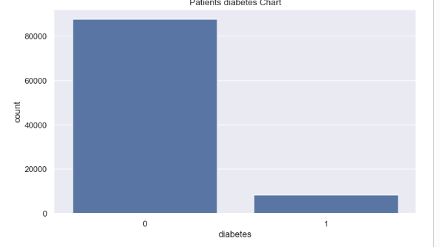
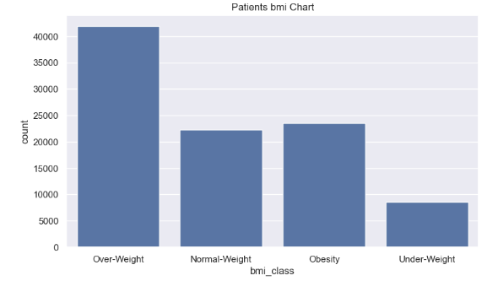
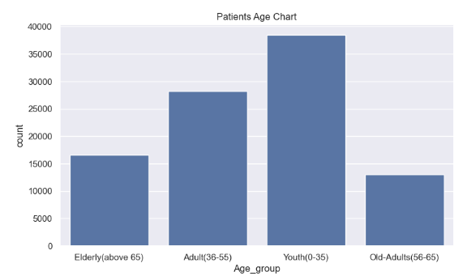
ACTIONS TAKEN
Using Python, I checked for missing values and data inconsistencies in the dataset, performed Exploratory Data Analysis to gain insights into the relationships between variables, performed weight assignment addressing the noted class imbalance, model training and evaluation using various machine learning model.

Slide 4
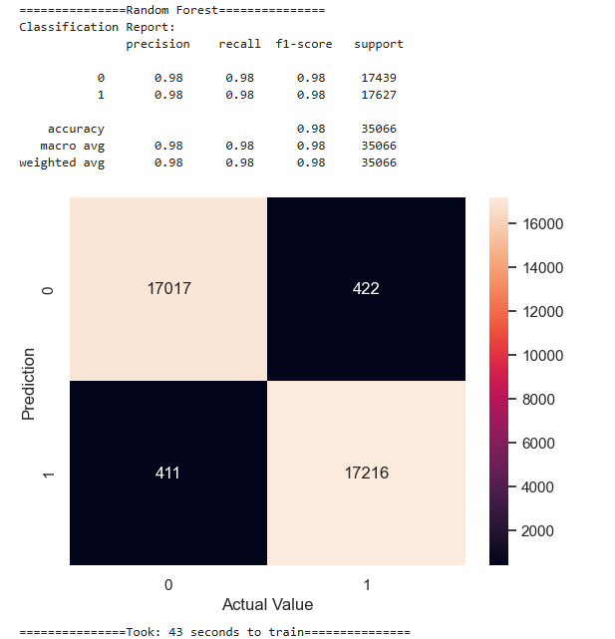
Model Evaluation and its Performance Metrics
Accuracy: 98% (Random Forest) the model correctly classifies most of the test data
Precision & Recall: 98% of the positive predictions were correct while effectively capturing almost all true positive cases.
Confusion Matrix
True Positives (TP) = 17,216 → Correctly identified diabetic cases.
True Negatives (TN) = 17,017 → Correctly identified non-diabetic cases.
False Positives (FP) = 422 → Non-diabetic cases wrongly classified as diabetic.
False Negatives (FN) = 411 → Diabetic cases wrongly classified as non-diabetic.

Slide 5
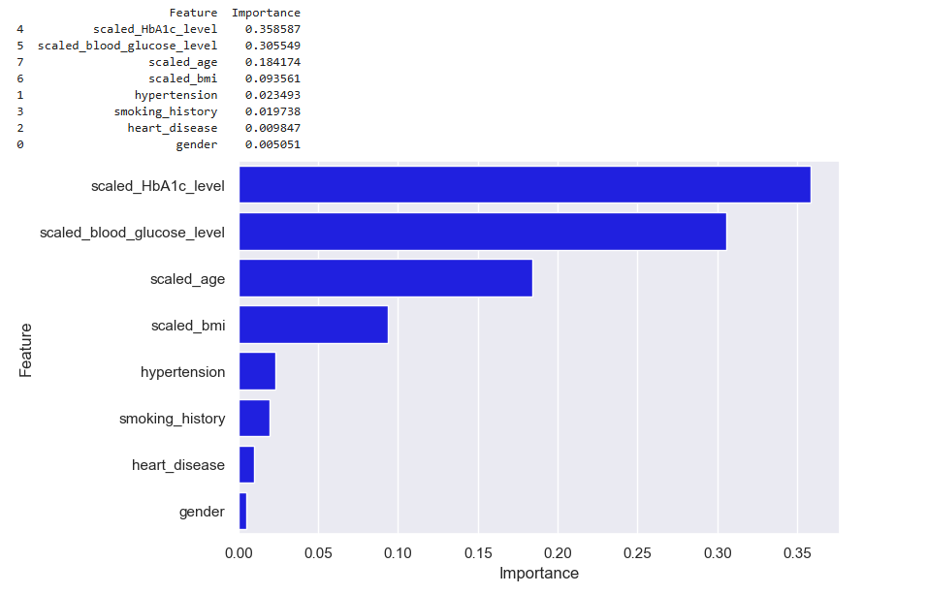
Feature Importance
RESULT
Achieved 98% accuracy with Random Forest.
Enhanced early diagnosis.
Reduced false negatives, ensuring fewer missed
diabetic cases.
Improved decision-making by providing clear feature
explanations.
CONCLUSION
The model evaluation demonstrates high accuracy of 98%, with very few false positives and false negatives.
The confusion matrix further confirms the robustness of the model, strong precision and recall, meaning it correctly identifies and captures relevant instances with minimal errors. The model took 43 seconds to train, indicating reasonable training efficiency.
This Random Forest model is well-optimized for the classification task, providing high reliability in predicting outcomes.

Slide 6
THANK YOU

